Slide 1


Build a Stronger Association!
Membership Recruitment and Retention
Tools to Help You Succeed

Slide 2
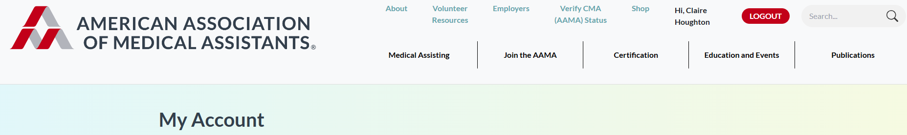
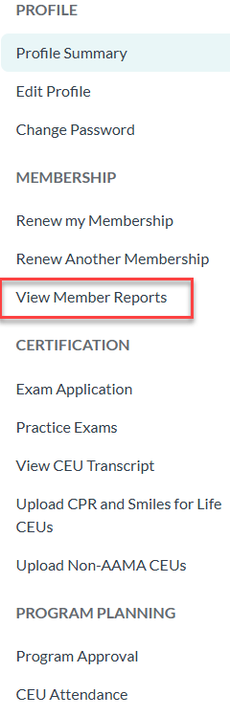
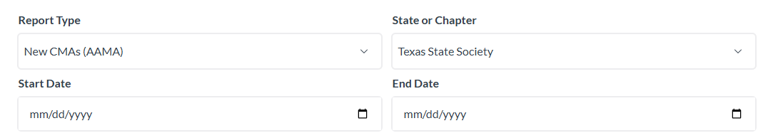

AAMA State/Chapter CMA (AAMA) Lists
Sign in and find member lists under the “My Account.”
Your role at the state or local level determines your access.
Access will be available to the following lists:
  Membership Roster: Current members
  Nonrenewing Members: Delinquent members
  Nonmember CMAs (AAMA): CMAs (AAMA) who never joined or haven’t renewed
  New CMAs (AAMA): Those who recently passed the CMA (AAMA) Exam.
DARK GREY
R: 51 G: 63 B: 76
#333F4C

Slide 3
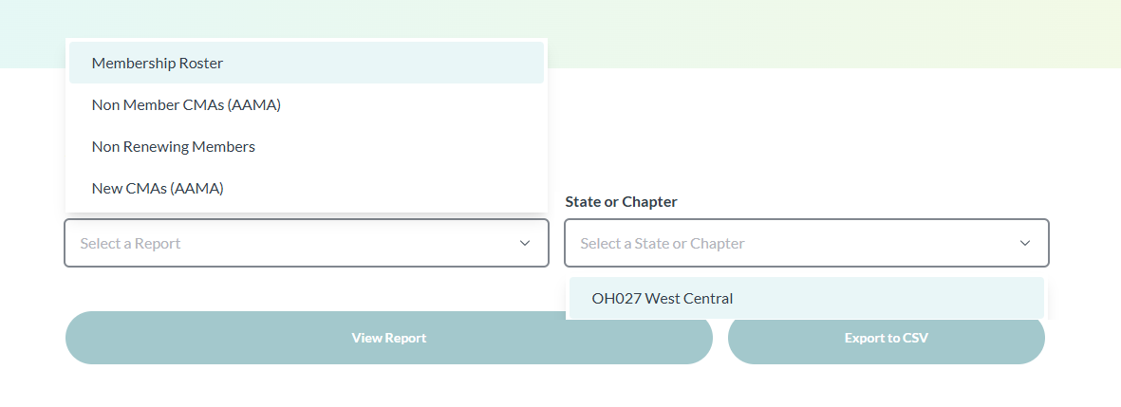
Use the lists to help increase your membership.
Market to existing members, as well as
nonmember CMAs (AAMA).
Within these lists you can do any of the following:
  Display a list of CMAs (AAMA). Export to Excel.
  You can then upload to mass email or print mailing labels. Request a list in label format from the AAMA.

Slide 4
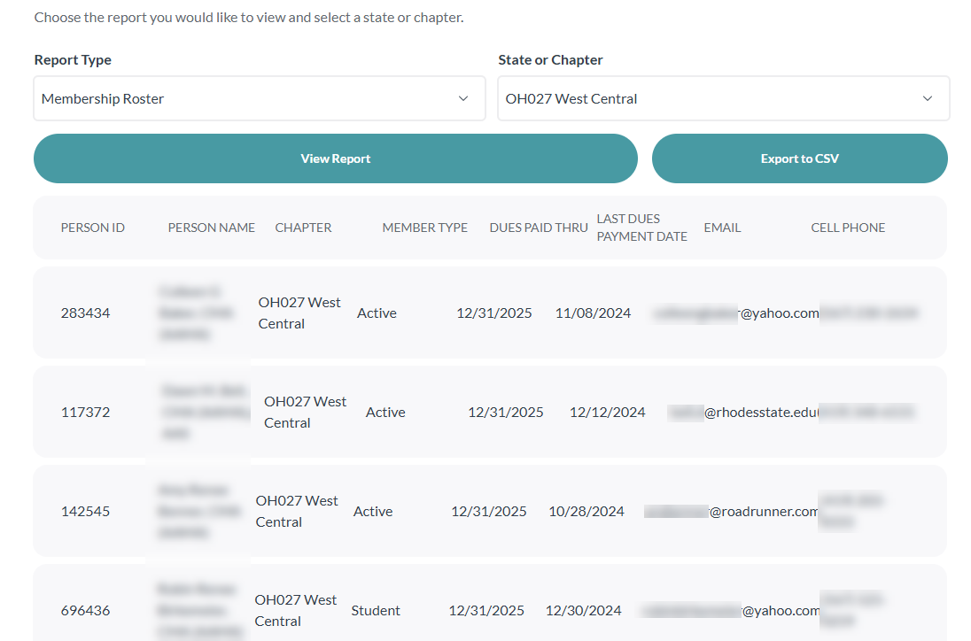
View name, address, and email. Easily identify when members last paid their dues and when their dues expire.

Slide 5
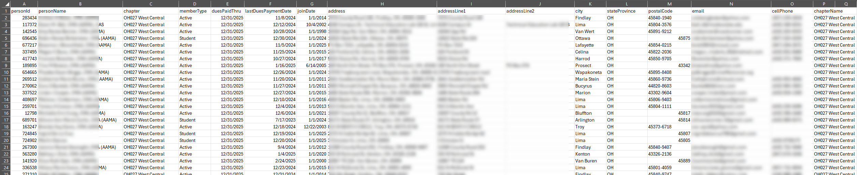
View the same information in Excel format with
additional columns.
Sort columns by city, zip code, or another specification.
DARK GREY
R: 51 G: 63 B: 76
#333F4C

Slide 6

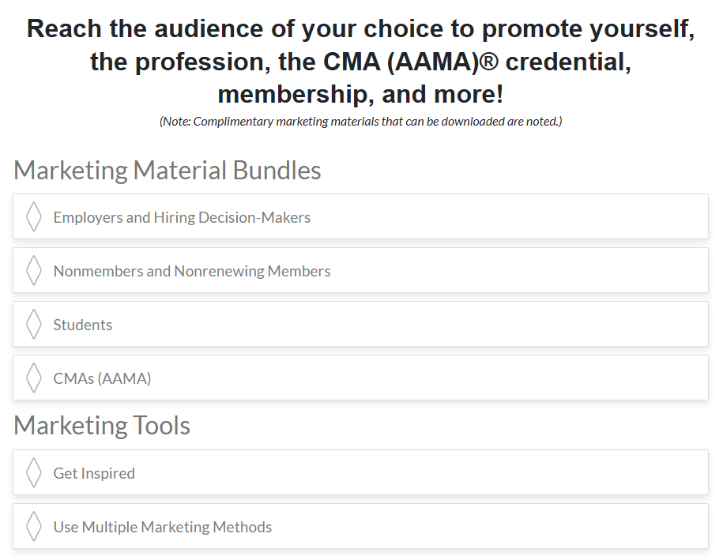


Resources
DARK GREY
R: 51 G: 63 B: 76
#333F4C

Slide 7
Recruit and Engage
New and Young Members
DARK GREY
R: 51 G: 63 B: 76
#333F4C

Slide 8
Why are they not joining?
Reasons young medical assistants don’t join:
  Don’t know about the organization.
  Don’t realize the organization is for them.
  Don’t see the value in being a member.
  Time does not allow for in-person meeting
Value trigger point
  The point at which the member sees the value in being a member.
    Determine what is that one benefit that attracts and brings the target population to the organization.
    *Amanda Kaiser | Smooththepath.net
DARK GREY
R: 51 G: 63 B: 76
#333F4C

Slide 9
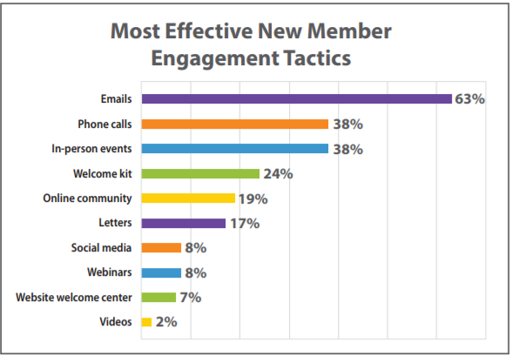
Reach out to members and nonmembers
Let them know you are there, and our association is for them!
  Use the member lists to reach out:
    Emails
    Personal phone calls
    Letters/postcards
    Social media
    Follow up with members
DARK GREY
R: 51 G: 63 B: 76
#333F4C
Smooththepath.net

Slide 10
Reach out, cont.
  Utilize your membership committee to engage with the members/nonmembers to attend meetings/education.
  Create a Welcome Committee – or have it as part of the Membership Committee
      Welcome new members and help establish an
      immediate sense of belonging.
      Ask newcomers where they work, what brought them to the meeting, and what they do.
      Introduce new members to a veteran member.
      Observe new members throughout the event and
      work to enhance engagement.
      Making that personal connection with them will help them to be engaged
DARK GREY
R: 51 G: 63 B: 76
#333F4C

Slide 11
Observe members
Observe members at events:
  Are they there alone?
  Are they interacting with others?
  Are your members interacting with them?
  What are their reactions to what is happening?
Put yourself in their shoes―what do you see?
  How are the members treating them?
  How would you feel if you were that member?
Use this information to determine what else you can do to recruit and retain your members.
DARK GREY
R: 51 G: 63 B: 76
#333F4C

Slide 12
Engage Attendees
Make sure they feel welcomed and that they bring value to the organization.
Use a mentor/mentee program to help give them the resources to be successful in their career and future role within the organization.
Ensure that long-term members are welcoming and see the value in new and innovative ideas.
Encourage them to volunteer and serve on committees―get them involved.
DARK GREY
R: 51 G: 63 B: 76
#333F4C

Slide 13
Engage student members
Get students involved.
  Have a student representative on your committees―have them get other students involved.
Offer a new member orientation program―explain:
  Member benefits
  How to recertify
  How to renew membership
Add a 10-minute session to each of your meetings to go over these items―don’t assume everyone knows.
Follow up with contacts made.
DARK GREY
R: 51 G: 63 B: 76
#333F4C

Slide 14
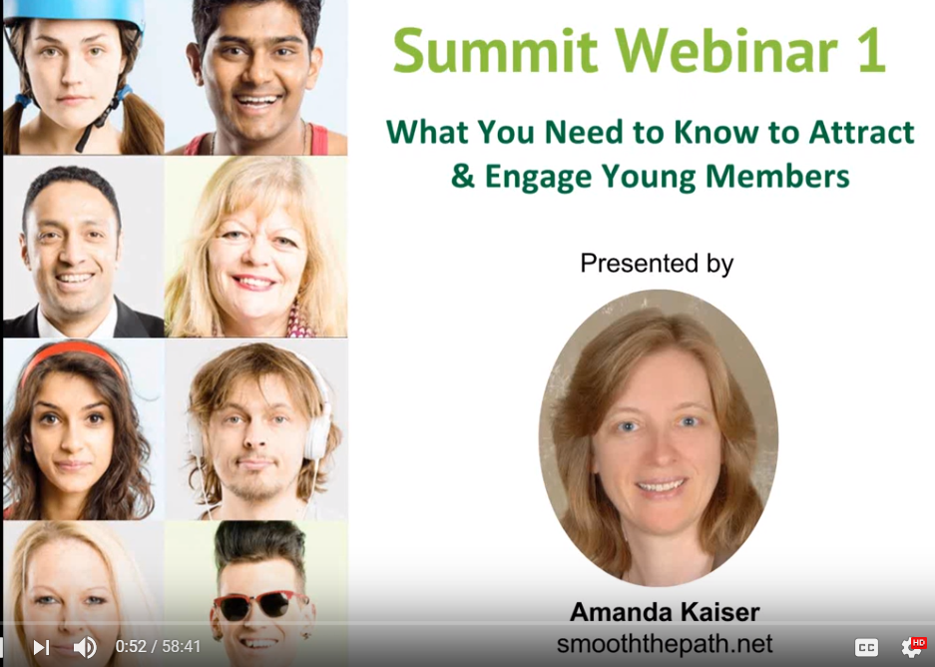
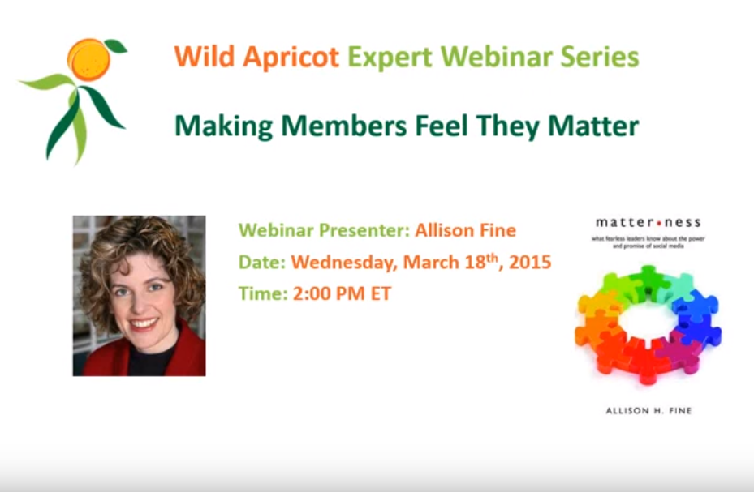

https://youtu.be/Kl6R92zxLic https://youtu.be/uZ6f_hfv_nw
https://youtu.be/0JIn4015d6M?list=PLN0oCHU1v8zhIEN69iBIdJLi6VQOpc_0K
DARK GREY
R: 51 G: 63 B: 76
#333F4C

Slide 15

Thank you–
Additional contact information –

